Slide 1
MODELING AND SIMULATION OF ARMATURE CONTROLLED DC MOTOR USING MATLAB
Research paper presentation by Arian Wazed

Slide 2
OVERVIEW
Mathematical modeling | Develop equations and parameters for the DC motor.
MATLAB and Simulink | Use these tools for simulation and control system design.
Armature control | Investigate various control strategies for motor optimization
Performance analysis | Evaluate the motor's behavior and efficiency through simulations.
Practical applications | Beneficial for industries like robotics, automotive, and automation.

Slide 3
Significance
Enables engineers to optimize motor performance, enhance efficiency, and develop advanced control strategies.
Has practical applications in various industries, including robotics, automotive, and industrial automation, making it crucial for improving energy efficiency and overall system performance.

Slide 4
01
MATLAB - A HIGH LEVEL PROGRAMMING LANGUAGE
Numeric computation, programming, and visualization.
Basic functions of Matlab:
Plotting of functions and data
Creation of user interfaces
Matrix manipulations

Slide 5
LITERATURE REVIEW
A.Maria
Jide Julius, P et.al
Devendra K. Chaturvedi
L.Y. Hui, and K.H. Seok
T. Kailath, Prentice Hall
Modeling and simulation research interests
Simulation model of armature controlled DC motor
Implementing full-order and reduced-order observers
Optimization of PID Controller with Metaheuristic Algorithms
Filtering and smoothing data from dynamic models

Slide 6
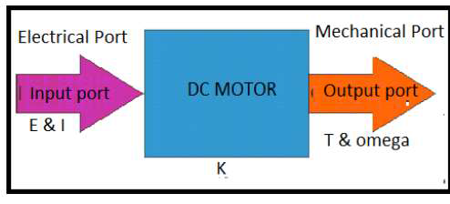
RESEARCH METHODOLOGIES
DC Motor Circuit Diagram
Field Flux Control Method
Representation of armature controlled DC motor
Controlling motor speed by varying field current
Figure of a simplified DC Motor
Shunt Motor
Series Motor
Diverter
Controlling field current with a shunt field regulator
Jupiter is the biggest planet of them all
Reduce the current flowing through the field winding

Slide 7
PROBLEM FORMULATION
1) Failure to start
2) Sparking at brushes
3) Vibrations and pounding noises
4) Overheating of DC Motor
5) Brush troubles
6) Commutator troubles
7) Armature troubles
Figure of a simplified DC Motor

Slide 8
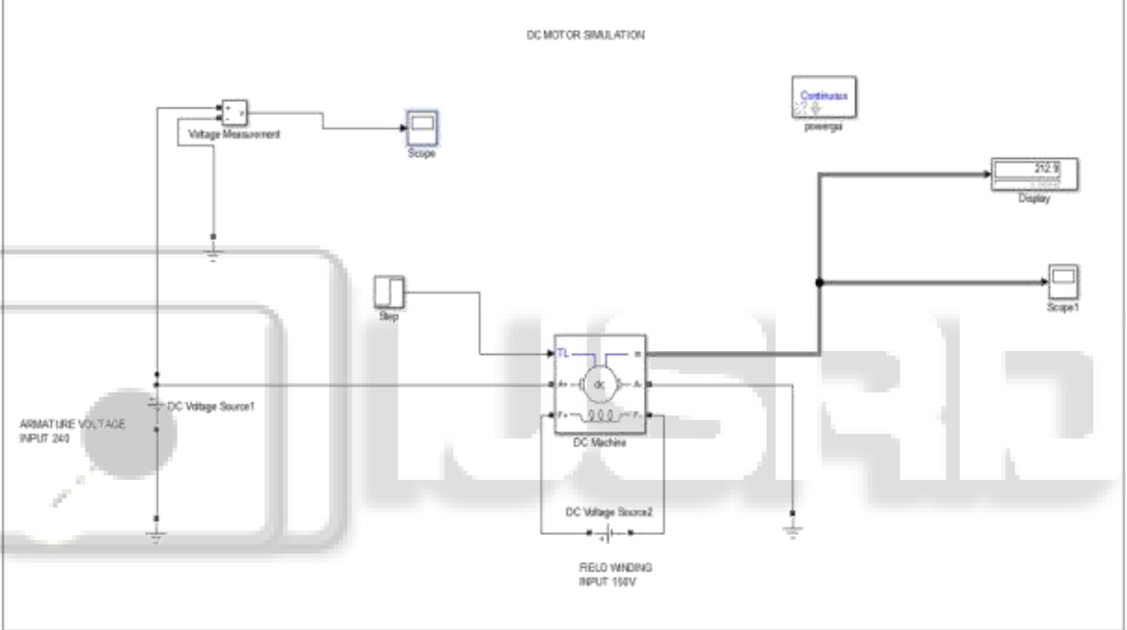
Diagram of a simple electrical circuit of armature controlled DC motor
Model created in SIMULINK toolbox of MATLAB

Slide 9
- Simulation Duration: 0 to 14 seconds.
- Constant Mechanical Load Applied.
- White Noise Added to Mechanical and Electrical Parts for Stability Testing
- Adjustable Gain for Mechanical and Electrical Disturbances.
- Armature-Controlled DC Motor: Inherently Stable Due to Proportional Back EMF.
- No Control Added to the Model Initially.
- Objective: Implement Control System by Adding a Controller.
- Feedback Loop Required (Rotational Encoder or Resolver) for Controller.
- Simulation and Analysis Focused on Steady State Responses.
- Motor Specifications: 5 hp, 1750 rpm, 240 Armature Voltage, 150 Field Voltage.
- Initial Conditions Assumed to be Zero.
- No Current Flowing at Motor Start.
RESULT AND DISCUSSION

Slide 10
ANALYSIS
Analysis Divided into Subsections:
Steady State Response: show the operating characteristics of the motor under different conditions.
Consideration:
i. Field current speed characteristics.
ii. Torque speed characteristic
Transient Response:
i. Variation of kkf remains ineffective on the stability or performance of the motor.
ii. The amplitude of the output increases.

Slide 11
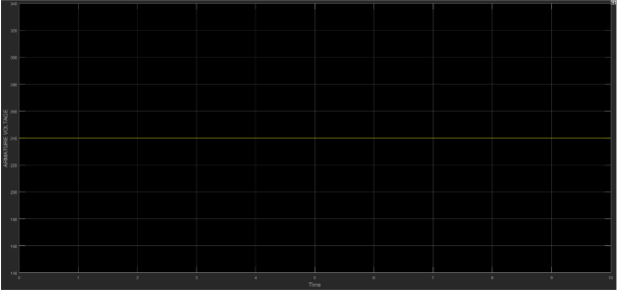
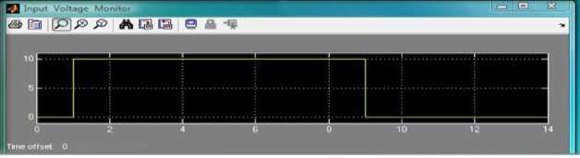
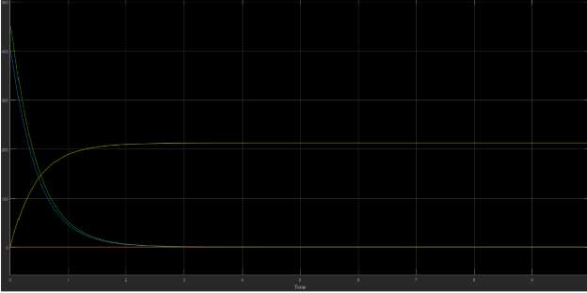
SIMULATION OUTPUTS
Torque–speed characteristic for different field current
Responses of the motor to a unit step input
Plot of the field current against motor speed

Slide 12
Recommendations
- Explore different feedback strategies to enhance the stability of systems with varying responses.
- Consider advanced control techniques to improve the system's robustness in the presence of external disturbances.
- Investigate the impact of different initial conditions on system behavior and assess methods to mitigate their effects.
- Conduct further research to explore the application of these findings in practical control systems.
- Continue analyzing the effects of field current changes on motor performance to optimize motor control strategies.

Slide 13
CONCLUSION
- Successful simulation of DC motor, armature-controlled systems using MATLAB.
- Initial response plots for all proposed systems generated.
- Feedback signal magnitude is crucial when dealing with substantial unknowns.
- Each system exhibits a different output feedback response, and not all can be stabilized to desired poles.
- Stabilizable systems provide satisfactory estimates, even in the presence of external noise input and torque disturbances.
- Discussion on field-controlled DC Motor in MATLAB-SIMULATION.

Slide 14
THANK YOU

